Slide 1

SWACHH BHARAT ABHIYAAN
Presented By : Parth Kalkar
B.Tech Ist Year.

Slide 2

Table of Contents
Introduction.
Background.
Objectives.
Public Awareness. 5.Brand Ambassadors. 6.Top 10 Cleanest Cities.
Campaign Realistic or not.
SBA Dream or Possibility.
India’s Filth figures.
Mission Hit or Miss.
Conclusion.

Slide 3
Introduction
Swachh Bharat Abhiyan (Hindi : स्वच्छ भारत अभभयान, English: Clean India Mission and abbreviated as SBA or SBM for "Swachh Bharat Mission") .
» Slogan : One step towards cleanliness.
» It is a national campaign by the Government of India, covering 4,041 statutory cities and towns, to clean the streets, roads and infrastructure of the country.
» The campaign was officially launched on 2 October 2014 at Rajghat, New Delhi , where Prime Minister Narendra
Modi himself cleaned the road.
» It was performed in remembrance of Gandhi's words.
» It is India's biggest ever cleanliness drive and 3 million government employees and school and college students of India participated in this event.

Slide 4
Background
With effect from 1 April 1999, the Government of India restructured the Comprehensive Rural Sanitation Programme and launched the Total Sanitation Campaign (TSC) which was later (on 1 April 2012) renamed Nirmal Bharat Abhiyan (NBA).
On 2 October 2014, Prime Minister Narendra Modi launched the Swachh Bharat Mission, which aims to eradicate open defecation by 2019, thus restructuring the Nirmal Bharat Abhiyan.
This campaign aims to accomplish the vision of “Clean India” by 2nd October 2019, 150th birth anniversary of Mahatma Gandhi and is expected to cost over INR 62000 Crore . This campaign was described as “beyond politics” and “inspired by patriotism”.

Slide 5

Objectives of Swachh Bharat Abhiyaan
Construction of Individual, Cluster and Community toilets.
To eliminate or reduce open defecation.
Public Awareness to be provided .

Slide 6

Objectives of Swachh Bharat Abhiyaan
An accountable mechanism of monitoring toilet use.
To keep villages | clean. Solid and | liquid | waste
management through | Gram Panchayat.
To lay water pipelines in all villages by 2019.

Slide 7
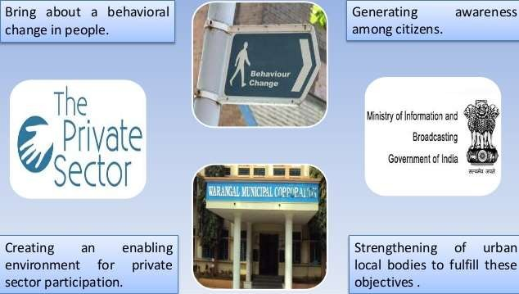
Public Awareness

Slide 8
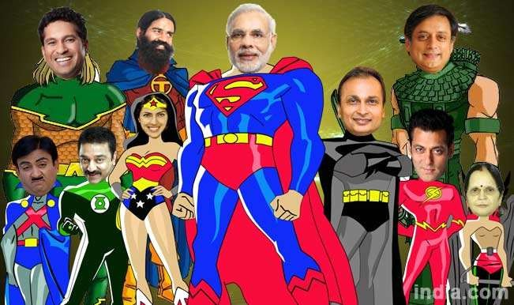
Brand Ambassadors

Slide 9


Slide 10
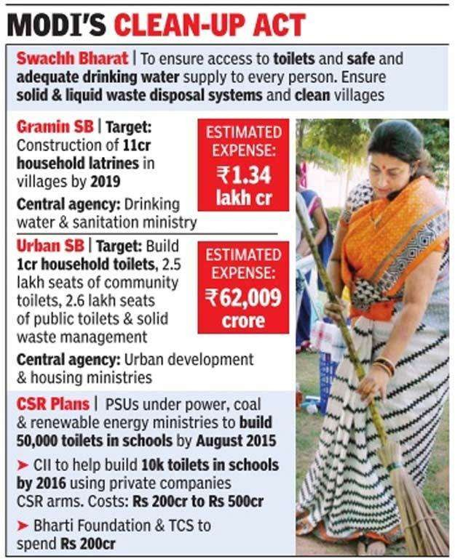

Slide 11
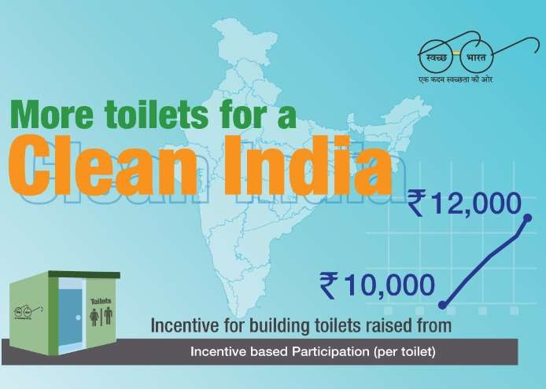

Slide 12
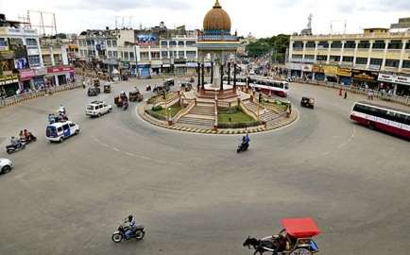
Top 10 cleanest cities of India (2016 Survey)
On 15th Feb, 2016 The Swachh Bharat Survekshan.
Mysore (Karnataka).
Chandigarh (UT).
Tiruchirapalli (Tamil Nadu).
New Delhi Municipal Council.
Visakhapatnam (Andhra Pradesh).
Surat (Gujarat).
Rajkot (Gujarat).
Gangtok (Sikkim).
Pimpri-Chindwad (Maharashtra).
Greater Mumbai (Maharashtra).
MYSORE CITY

Slide 13
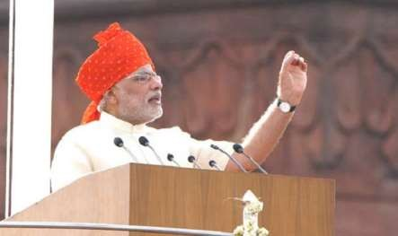
How Realistic is the Swachh Bharat Campaign ?
Under pressure things happen faster.
20 millions toilets by 2015.
Less than One third Indian have access to sanitation facilities.
Around 4 lakhs – 0 to 5 years old die due to unsafe drinking water.
Only 22% of rural household use Sanitary facilities.
Caste is a major problem.
“ If we Indians can reach Mars then , can’t Indians go and clean our streets and roads”.
This is a very difficult mission ,
but by 2019 we should accomplish it.

Slide 14
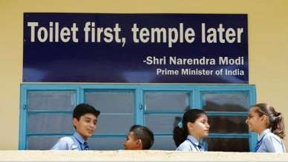
Swachh Bharat Campaign – Dream or Possibility
First step element of psychology - first toilets at school- this will change the approach to defecation.
Insanitation causes an expense of Rs 500 per month and Rs 7000 for every individual every year.
Lets teach Swachh Bharat as a Right and Responsibility. Freedom from dirt and filth should be taken as fundamental right and responsibility.
A additional cess of 0.5% for Swachh Bharat is being levied in proportion to the taxable services from November 2015.

Slide 15
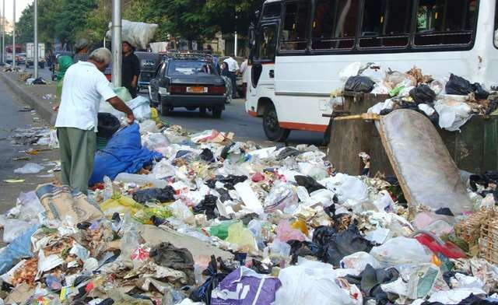
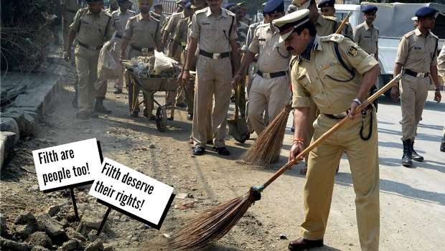
India’s Filth Figures
According to Census 2011, the Urban Slum figures:
68 million people live in slums.
34% have no toilets at their homes.
63% own mobile phones.
44.3% have open drainage in slums.
1,88,500 tones of waste generated by India per day.
68.8 million tones of waste generated by India per year.
8,500 tones waste generated by Delhi per day.
0.2-0.6 kg garbage generated per head per day in India.

Slide 16
Swachh Bharat Abhiyaan – “Hit or Miss”.
Swachh Bharat only Noise, No Action. 1.Target- 25 lakhs individual toilets by 2019.
4.6 lakhs installed.
12 lakhs under progress.
Success Rate – 18% .
Target- 100000 community toilets by 2019.
25000 toilets installed.
Success Rate – 25% .
Target- 1000 cities with 100% solid waste management by 2019.
Only 2 have achieved.
Success Rate – 0.2% .

Slide 17
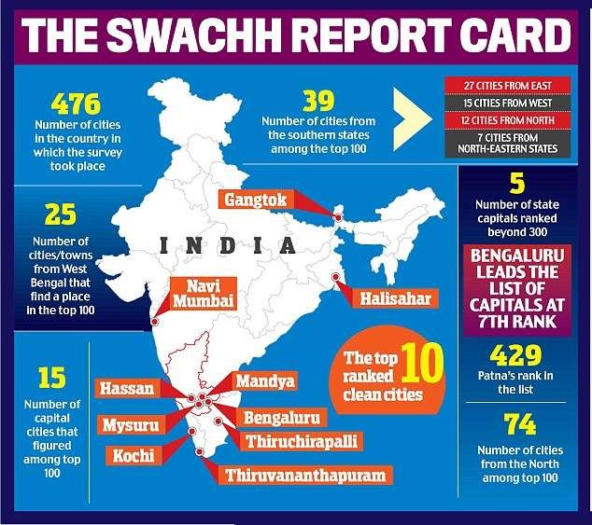

Slide 18
Conclusion
Not to be disillusioned by the reports of slow progress.
Somewhere somebody is listening , doing their bit.
Lets look at the glass as half full and not half empty because we have come from nothing to this place.
Role of Youth – by inculcating culture of self service and cleanliness we can bring change.
Swachh Bharat Abhiyaan should be taken forward as a National Initiative irrespective of its name and fame.
Attitudes towards cleanliness is changing but we must not forget we have miles to go.

Slide 19

THANK YOU !!!

